Slide 1
Consumer goods Ad_Hoc Insights

Slide 2
Agenda
About company
Purpose of Analysis
Data model
Ad_hoc requests

Slide 3
About Company
Atliq Hardwares (imaginary company) is one of India's leading computer hardware producers and well expanded in other countries.
However, the management noticed that they do not get enough insights to make quick and smart data-informed decisions. They want to expand their data analytics team by adding several junior data analysts. Tony Sharma, their data analytics director wanted to hire someone who is good at both tech and soft skills. Hence, he decided to conduct a SQL challenge which will help him understand both the skills.

Slide 4
Purpose
The purpose of this analysis is to provide actionable insights into various aspects of Atliq Hardwares' business operations. By analyzing data related to customer behavior, product performance, market trends, and sales channels, we aim to equip the management with the information needed to make informed, data-driven decisions. This analysis addresses specific ad-hoc requests from the business, focusing on critical areas that impact strategic planning and operational efficiency.

Slide 5
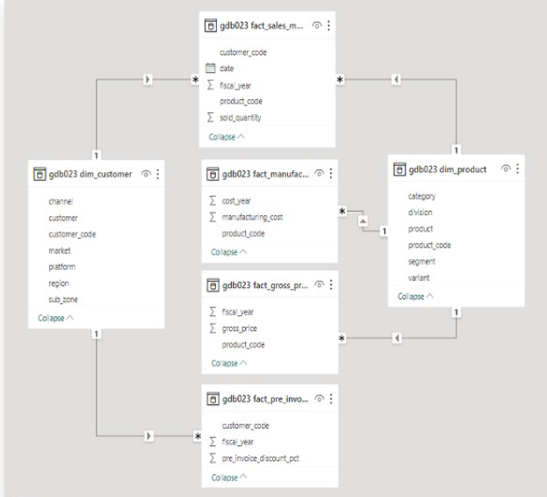
Data model

Slide 6

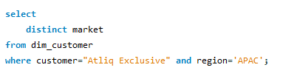
Queation1. Provide the list of markets in which customer "Atliq Exclusive" operates its business in the APAC region.
Output

Slide 7
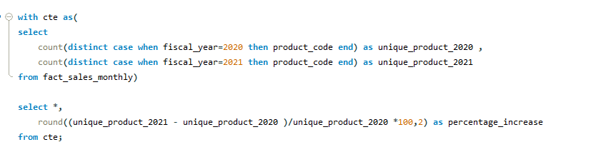
Question2. What is the percentage of unique product increase in 2021 vs. 2020? The final output contains these fields: unique_products_2020, unique_products_2021, percentage_chg

Slide 8

Output
Insights:
There was a significant increase in unique products from 2020-2021.
The no. of unique products grew from 245 in 2020 to 334 in 2021, representing a 36% increase.

Slide 9
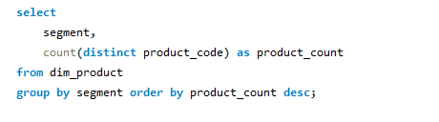
Queation3. Provide a report with all the unique product counts for each segment and sort them in descending order of product counts. The final output contains 2 fields: segment, product_count

Slide 10
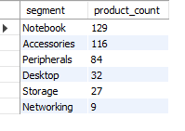
Output
Insights:
The Segment with the highest number of unique products is ‘Notebook’ followed by ‘Accessories’ and ‘peripherals’.

Slide 11
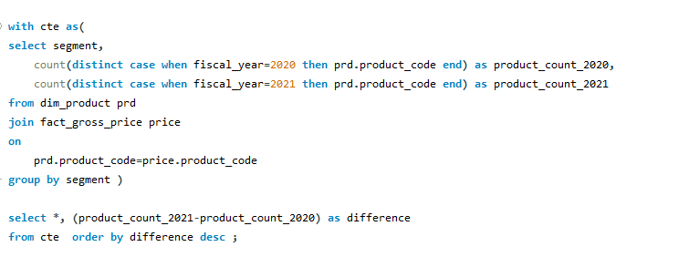
Question4. Follow-up: Which segment had the most increase in unique products in 2021 vs 2020? The final output contains these fields: segment, product_count_2020, product_count_2021, difference

Slide 12
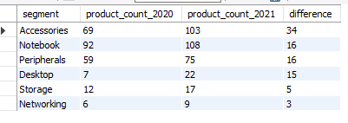
Output
Insights:
‘Accessories’ has most significant increase in unique products from 2020-2021, with an increase of ‘34’ products.
‘Notebook’ and ‘peripherals’ also show notable growth, indicating successful product development in these areas.
‘Storage’ and ‘Networking’ has very less increase in unique products.

Slide 13
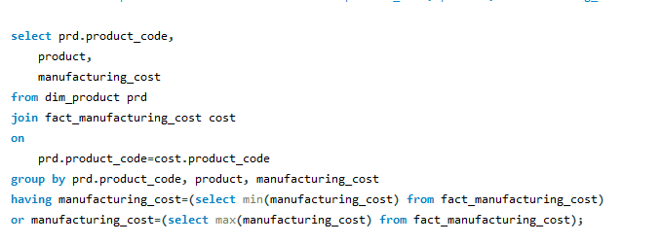
Queston5. Get the products that have the highest and lowest manufacturing costs. The final output should contain these fields: product_code, product, manufacturing_cost

Slide 14

Output
Insights:
-The product with the highest manufacturing cost is ‘AQ HOME Allin1 Gen 2 ‘ which costs ‘240.5364 ‘ rupees.
-The product with the lowest manufacturing cost is ‘AQ Master wired x1 Ms ‘ which cost ‘0.892 ‘ rupees.
-Understanding these costs helps in pricing strategy and cost management.

Slide 15
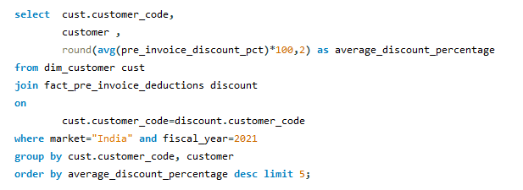
Question6. Generate a report which contains the top 5 customers who received an average high pre_invoice_discount_pct for the fiscal year 2021 and in the Indian market. The final output contains these fields: customer_code, customer, average_discount_percentage

Slide 16
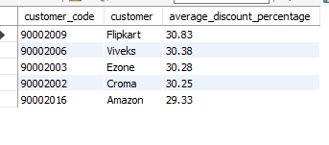
Output
Insights:
-In top 5 ,the top customer receiving the highest average discount is ‘Flipkart’ with ’30%’.
-The discounts provided to these top customers indicate strategic relationships and volume based pricing strategies.

Slide 17
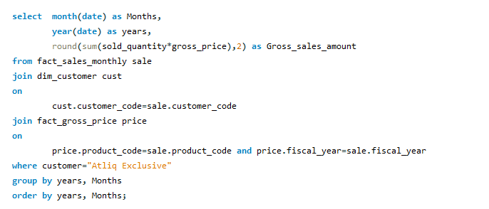
Question7. Get the complete report of the Gross sales amount for the customer “Atliq Exclusive” for each month. This analysis helps to get an idea of low and high-performing months and take strategic decisions. The final report contains these columns: Month, Year, Gross sales Amount

Slide 18
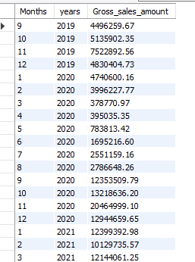
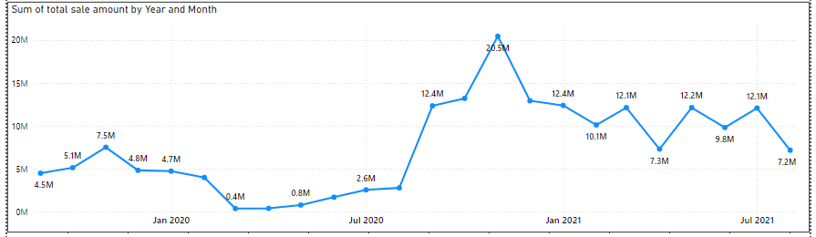
Output
Insights:
-The highest gross sales for “Atliq exclusive” were in “November 2020”.
-The lowest sales were in “March 2020”.

Slide 19
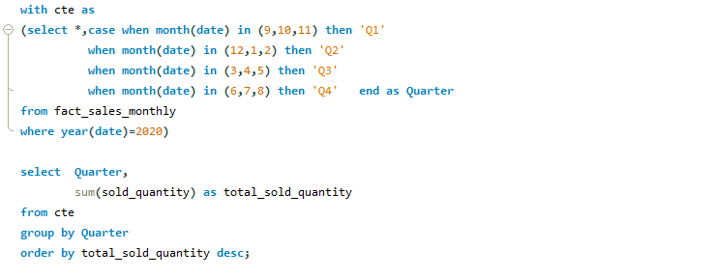
Question8. In which quarter of 2020, got the maximum total_sold_quantity? The final output contains these fields sorted by the total_sold_quantity, Quarter, total_sold_quantity

Slide 20
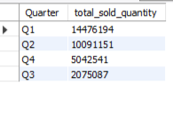
Output
Insights:
Quarter with maximum total sold quantity was “Q1” i.e sep-nov with 14 million units sold.

Slide 21
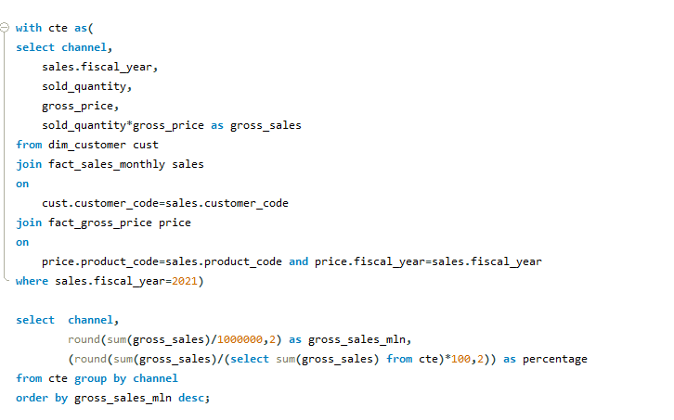
Question9. Which channel helped to bring more gross sales in the fiscal year 2021 and the percentage of contribution? The final output contains these fields: channel gross_sales_mln, percentage

Slide 22
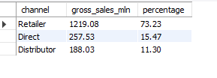
Output
Insights:
-The sales channel that contributed the most to gross sales in 2021 was ‘Retailer’ with ‘1219’ millions, representing ‘74%’ of total sales.
-This data highlights the effectiveness of the channel and its importance to the overall sales strategy.

Slide 23
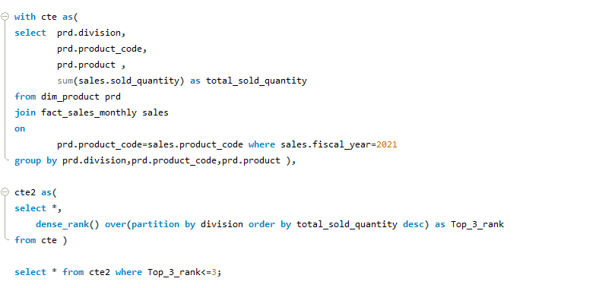
Question10. Get the Top 3 products in each division that have a high total_sold_quantity in the fiscal_year 2021? The final output contains these fields: division, product_code, product, total_sold_quantity, rank_order

Slide 24
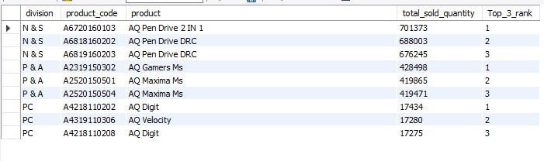
Output

Slide 25
Thank you

